Slide 1

Cyclistic Bike-Share
Analysis
Case Study – Google Data Analytics Capstone

Slide 2
About Cyclistic
Casual Riders
Full-day passes
Cyclistic Members
Single-ride passes
Annual memberships
Pricing Plan
Riders Type

Slide 3
Analytical Goal
Annual members are much more profitable than Casual Riders
Casual Riders are
already aware of
the Cyclistic program
Casual Riders have chosen Cyclistic
for their mobility needs
Maximizing the number of annual memberships
by converting Casual Riders into members
How Casual Riders and Annual Members
use Cyclistic bikes differently?

Slide 4
#1
How do Cyclistic Members (Annual Members) and Casual Riders use Cyclistic bikes differently?

Slide 5
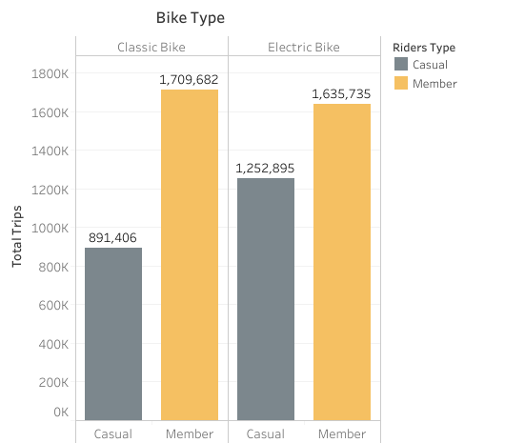
Total Casual Riders : 2,144,301
Total Cyclistic Members : 3,345,417
In 2022, Cyclistic Members rode
21.88% more often than Casual Riders.

Slide 6
Cyclistic Members
preferred to use classic bike.
Casual Riders
preferred to use electric bike.

Slide 7
#2
Why would Casual Riders buy Cyclistic annual memberships?

Slide 8
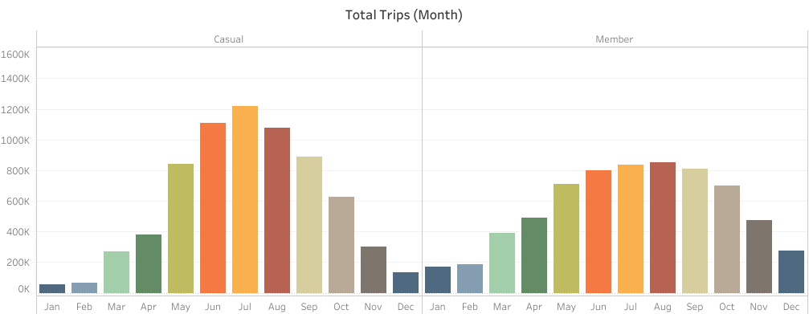
Both Cyclistic Members and Casual Riders rode more frequently during warm season,
but Casual Riders had more significant increase than Cyclistic Members.

Slide 9
Cyclistic Members ride’s numbers were more stable across weekdays,
but Casual Riders rode more often during weekend.

Slide 10
Both Cyclistic Members and Casual Riders rode longer during weekend,
but Casual Riders’ average duration in a week was 27.33% higher than Cyclistic Members.

Slide 11
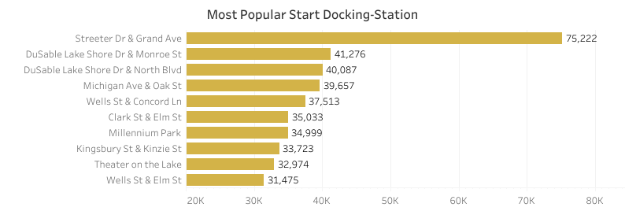
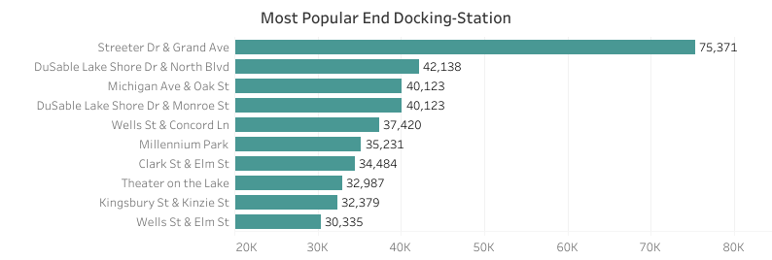
In 2022, most popular start and end station were Streeter Dr & Grand Ave.

Slide 12
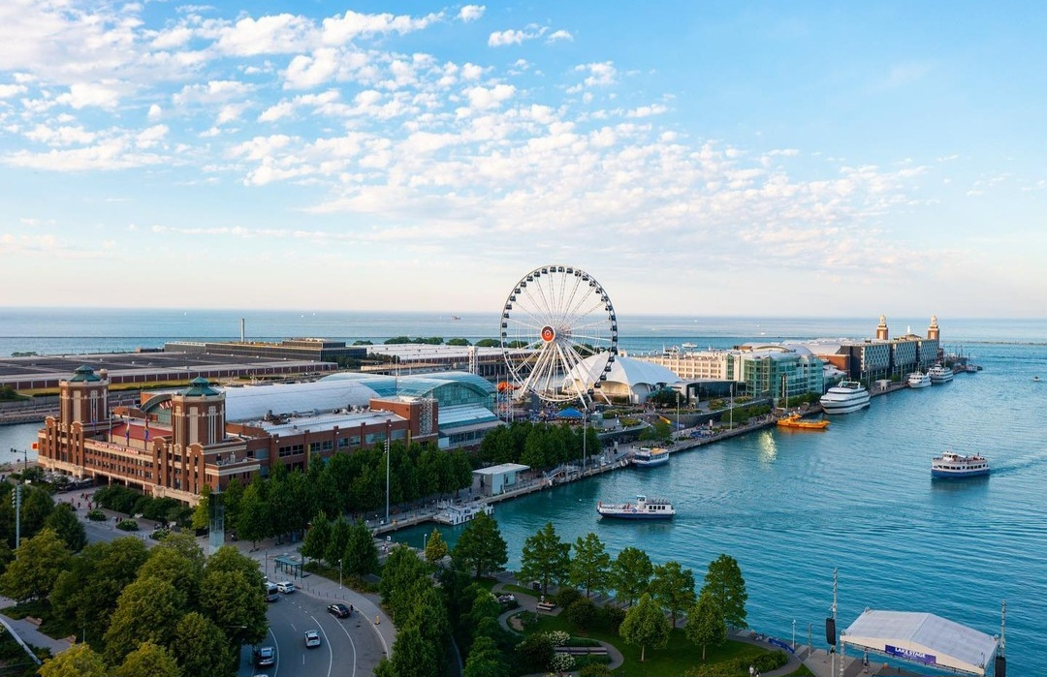
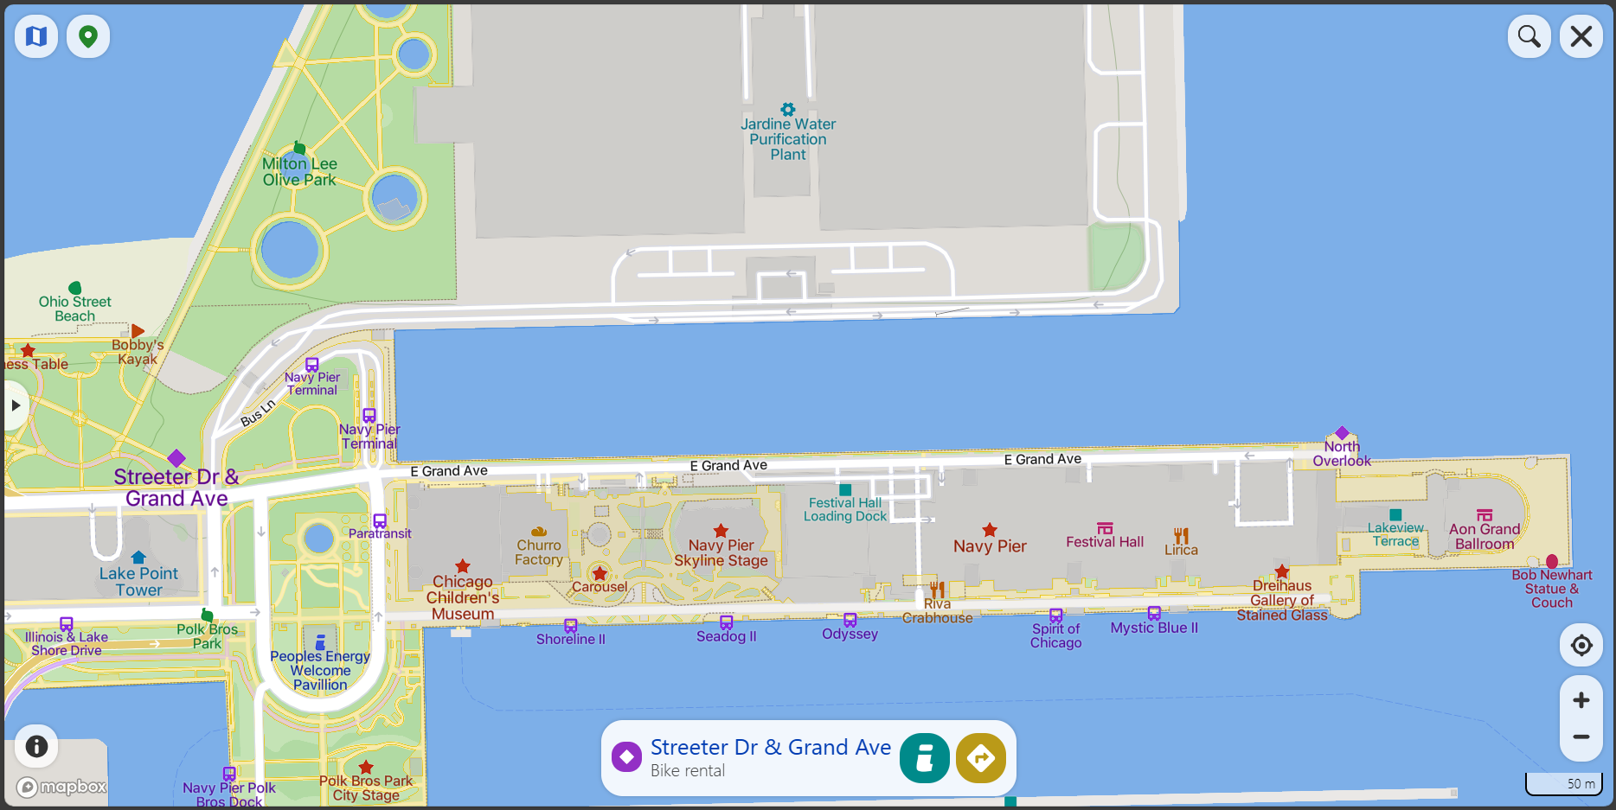
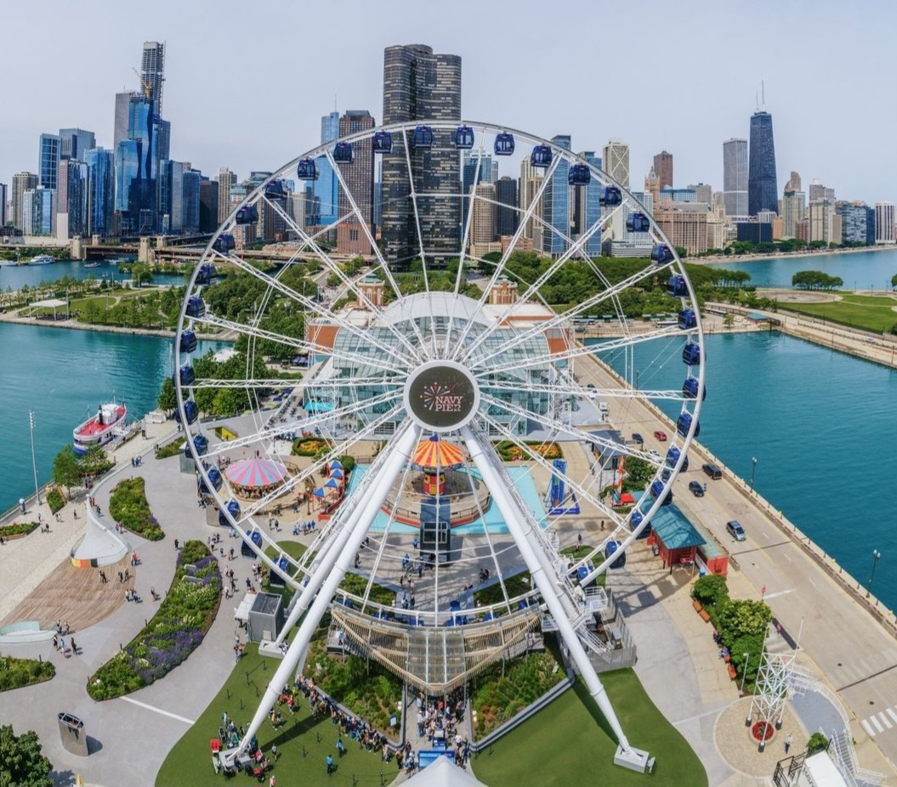
Streeter Dr & Grand Ave station is located around several recreational areas
such as Ohio Street Beach, Chicago Children’s Museum, and Navy Pier,
an apartment building Lake Point Tower, and several transit places.

Slide 13
Insights

Slide 14
Casual Riders preferred to use electric bike
Casual Riders’ ride number had a significant increase
Casual Riders rode more often and longer during weekend
Casual Riders’ average duration in a week was 27.33% higher
11% higher than Cyclistic Members
During warm season: May to October
Casual Riders usually rode for leisure
Casual Riders used Cyclistic to travel longer distances

Slide 15
Most Popular Stations:
Streeter Dr & Grand Ave
DuSable Lake Shore Dr & Monroe St
DuSable Lake Shore Dr & North Blvd
Michigan Ave & Oak St
Wells St & Concord Ln
Clark St & Elm St
Millennium Park
Kingsbury St & Kinzie St
Theater on the Lake
Wells St & Elm St

Slide 16
Recommendations

Slide 17


1
2
Provide more models of
electric bike
Add a special benefit only for
annual membership to enjoy
the latest model of electric bike
Collaborate with several universities
to target Casual Riders
who are university students
Offer a special annual
memberships price

Slide 18

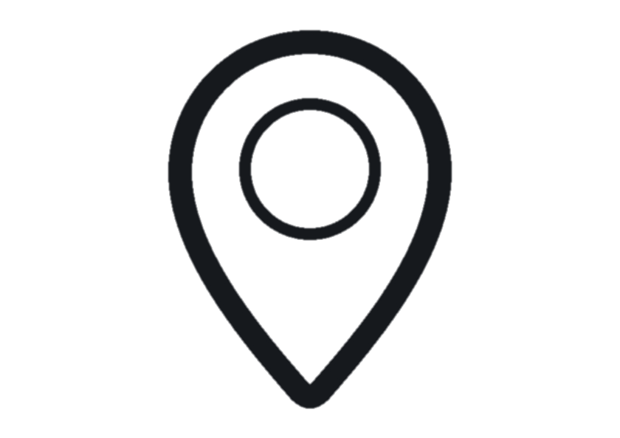
3
4
Choose promotional time based on day and month, when Casual Riders ride more often and longer
Focus the promotion
during weekend and warm season
(May to October)
Choose promotional location
in 10 most popular stations
and several recreational places
Place bigger advertisement
and host a few interactive events
about cycling as daily mobility

Slide 19
Thank You

